Slide 1



Cancer Screening & Patient Registration
GirlsGeeksInBlue
Team Members
Muthulakshmi A
Roshni Ramadasu Chandran
Samina Zareen
Shilpi Mittal
Sri Divya Rachuri
Vembu Muthuramalingam

Slide 2

Table of contents
Background | 3
Problem Statement and Solution Recommended | 4
Technology Used | 5
Cancer Screening and Patient Registration (CSPR) Apps | 6- 9
CSPR Hybrid App - Overview | 6
Functional – Justification | 5
Technical - Justification | 6
Context Diagram | 7
Work Flow Diagram | 8
Functional overview | 9
Cost/Benefit Analysis – Opex/ Capex | 10-11
Featured Recommended in Future | 12
USER MANUAL | 13

Slide 3
Background
Cancer Screening and Patient Registration (CSPR)
CSPR is one of the 5 project proposed by the NGO (Indian Cancer Society - ICS) to “The Tech for Good 2015” (the exclusive women-only) Hackathon contest organized by Anita Borg Institute http://anitaborg.org/ as part of the Grace Hopper Celebration for Women in computing http://gracehopper.org.in/
About India Cancer Society (ICS)
Indian Cancer Society (http://www.indiancancersociety.org/)was established in 1951 by Dr. D.J. Jussawalla and Mr. Naval Tata as India's first voluntary, non-profit, National Organization for Awareness, Detection, Cure and Survivorship of those affected with this disease.
Indian Cancer Society has been doing sterling work in fighting cancer across India. It has been and continues to be the beacon of hope for thousands of underprivileged cancer patients
GirlsGeeksInBlue - Team
83 companies from all over India participated in the hackathon held in the 5 regions. GirlsGeeksInBlue ,a team of ANZ women techies, are 1 amongst the 28 teams that were formed in the Bangalore Hackathon.

Slide 4
Problem Statement and Solution Recommended
Current State
ICS presently doesn't have any automated setup for patient registration and screening in the medical camps.
Volunteers capture data manually in cancer detection camps.
Data entry is either on Excel or on printed paper.
Registration & Tracking of patient is quite difficult.
Record handling is a challenge.
Future State
CSPR App will minimize and automate the task of registration and screening done at ICS camps
With the use of mobile and web application.
Volunteer/Doctor/ICS staff can use it with ease.
Record and track patients efficiently.
More user friendly and easy to use application.
How
ICS will provide a basic smartphone to Volunteers to enable them to register and screen patients .
ICS app will help volunteer/Doctor /ICS staff to register themselves with a login ID.
ICS app will maintain record of patient details and Doctor recommendation as and when needed.
ICS app will schedule Doctor appointment
ICS app will give dashboard view of patients registered in camps

Slide 5

Technology Used
Latest Technology Incorporated
Have tried to build up the App with latest technology being used in the market for web application development which can be accessible from smartphones or any system
Idea was to use all open source technology to save cost of licencing
Bring an App which can be accessible from any web-browser using either smartphone (Android)or laptop
24/7 usability from anywhere anytime.
For Demo , we have hosted our App on cloud using Google Cloud Platform
Indian Cancer society can use cloud features going forward to build up their infrastructure setup.
Technology
Stack
Bootstrap Framework/HTML5
MongoDb hosted in MongoLab
Express Server with Nodejs in Google Cloud Platform
Bridgeit- Hybrid Mobile development API
Jquery / Moment/Canvasjs
Responsive User Interface
Database
Web Server
Mobile API
Other UI Libraries

Slide 6




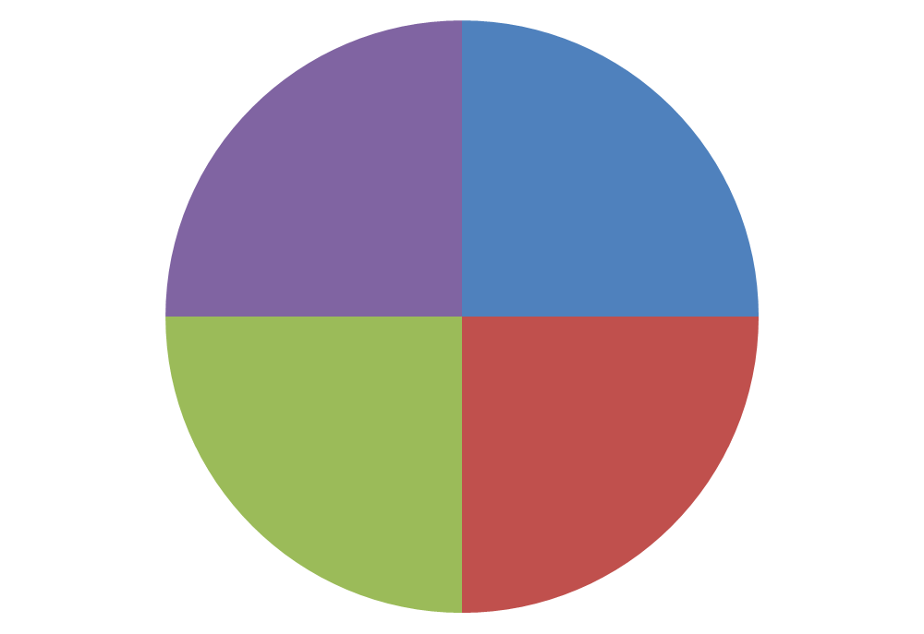
Cancer Screening Patient Registration (CSPR) Hybrid App - An Overview
CSPR app addresses the theoretical challenges in recording and maintaining patient information. The app is built to facilitate quick and accurate information capturing about the cancer patient in the medical camps conducted by Indian cancer society (ICS). The user of the app will be able to register, screen, view and provide feedback to patient which can be viewed by all ICS staff. The user can perform their assigned task in the easiest manner . Volunteer can direct patient to concerned doctor for proper treatment.
How CSPR App Helps ICS Camps
Patient details recorded quickly
Finding a patient with Patient ID
Emergency Action can be taken based on record available
Performance of camps registration and detection and easily being noticed by patient record
Register Volunteer/Doctor and ICS Staff
Register Patient Personal Details
Register Patient Clinical History
Register Doctor Recommendations
Register Feedback
Patient Record
Registrations
ICS Camps
Screening
Screen patient symptoms for cancer
Capture first hand information from patient
Quick review available for Doctor to start examination
Block Dr and Patient appointment
Symptoms get recorded for future reference.
Cancer details recorded accurately
Analysis of cancer found in patient can be easily traced
Dashboard view of cancer detection in camps can be managed easily
Cancer Detection

Slide 7
Functional Justification
Only Essential Features required for the project have been developed in view of the timeframe provided
App Features | benefits
User Registration | Have provided default user password for first User Login Default Password = ICS@123
Patient Registration | Patient registration capture complete details by Volunteer
Screening with camera | Patient Screening details can be filled by volunteer as many as he/she can and take photo of the effected areas with mobile camera . Then assign to Doctor
Search and update the patient details | Search and update details as and when required using patient ID PatientID = first four letters from First Name and First letter from last name with DOB in dd/mm/yyyy
Schedule Appointments for Patient/ Block Availability of Doctor | Volunteer can assign doctor based on his availability Doctor has to block his availability in the system with entering start and end date.
Star Rating | Doctor rating can be given by both volunteer and ICS staff based on the patient feedback. Final rating with be an average of all the ratings given to a particular doctor.
Dashboard | Viewed by all to see the latest statistics of the patient in camps, ie Gender wise /Area wise

Slide 8
Technical Justification
Technology | Benefits
Hybrid Apps / Cloud Hosting | Can be used from smartphone or any web browser . User Experience (UX)-Integration-Speed-Availability - Offline Use Portable – Accessible – user- friendly – Setup Calendar /Camera – 24/7 usability On demand self service – Load Balancing – Availability - Tools & Automation –Cost-effective.
MongoDb Database | BSON (Binary JSON -Java Script Object Notation), due to its binary format provide more reliable and more efficient in storage space and speed CMS: the flexible schema of MongoDB is great for heterogeneous collections of content
Bootstrap Framework/HTML/CSS | Base styling for most HTML elements- Comprehensive List Of Components Leveraging Javascript Libraries - Good documentation Responsive Grid - Ease Of Use - Highly Flexible
Express Server with Nodejs in Google Cloud Platform | Real-time Made Easy Tight coupling between client and server Platform control All developer knows Javascript in web development
Bridgeit- Hybrid Mobile development API | BridgeIt enables any web application to access a wide range of mobile device capabilities using a simple JavaScript API. BridgeIt is supported on the most popular mobile platforms, offering the features like camera, SMS, Cloud Push,Scan geotrack etc
Momentjs /Canvasjs Libraries | Moment is a Full featured date library for parsing, validating, manipulating, and formatting dates. CanvasjsHTML5 JavaScript Charts that are built on top of HTML5 Canvas Element

Slide 9








Context Diagram
Screen a Patients
Patients Register
Assign a Doctor
Cancer Detection Camps
Volunteer/Dr/ICS Staff Register
Clinical Examination By Dr
Patient Review and Follow-up

Slide 10
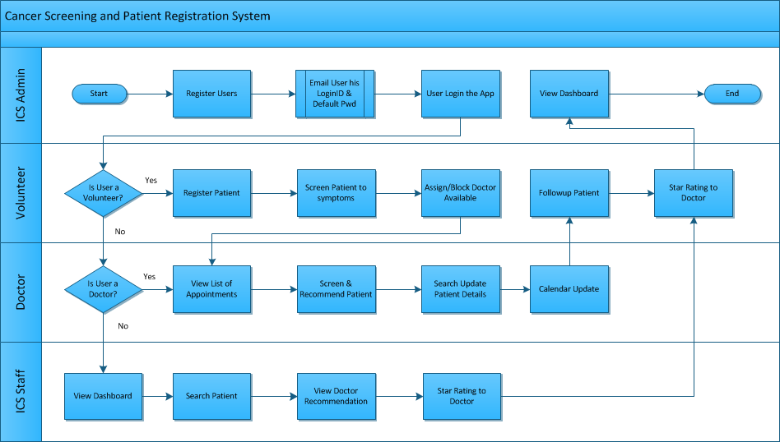
Workflow Diagram

Slide 11
Functional View
ICS App User
ICS Camp Dashboard
User Registration
Patient Registration & Screening
Doctor screening & Clinical Examination
Feedback and Followup
Volunteer
ICS Camps Assessment
ICS Doctor Review
Doctor
Volunteer
Doctor Assignment
Doctor Review
ICS Staff
ICS Admin

Slide 12
Cost Benefit Analysis – Opex Value
Tangible Impact | Current Scenario |  | Future Scenario
Output | Cost | Quality | Cost | Quality
Per Registration | Manually (Paper/Pen) | Handwritten/Non-Readable | CSPR App (Internet) | System generated
Per Screening | Manually (Paper/Pen) | No define Format, Randomly data collected | CSPR App (Internet) | System generated
Per Dr Appointment | Manually (Paper/Pen) | Doctor search and availability delay | CSPR App (Internet) | System generated
Analytics | Manually (Paper/Pen) | Collaboration of different input missing | CSPR App (Internet) | Integration of All Inputs
Intangible Impact | Current | Future
Accountability | Yes | Yes
Capability | No | Yes
capacity | No | Yes
Communication | No | Yes
Engagement | Yes | Yes
Satisfaction | No | Yes
Innovation | No | Yes
Leadership | Yes | Yes
Stress | High | Low
Team effectivenes | No | Yes
Work Balance | No | Yes
Assumption
Android Mobile availability with internet
Volunteer/DR having knowledge of using App
1 camp cost Rs 500 (Paper/Pen/Printout )in Current senario
1 Camps Cost Rs 100 (Internet connection) in Future Senarion.
2 Camps per month in one location
Outcomes
Huge Operational cost and Time will be save by implementing the CSPR Hybrid App in the running Camps by ICS.
One Location | Current Cost | Future Cost | Cost Saved | ROI
1 Camps | ₹ 500.00 | ₹ 100.00 | ₹ 400.00 | 80%
2 Camps (Per Month) | ₹ 1,000.00 | ₹ 200.00 | ₹ 800.00 | 80%
12 Camps (Half Yearly) | ₹ 6,000.00 | ₹ 1,200.00 | ₹ 4,800.00 | 80%
24 Camps (Yearly) | ₹ 12,000.00 | ₹ 2,400.00 | ₹ 9,600.00 | 80%

Slide 13
Cost Benefit Analysis – Capex Value
Capital Investment | Cost | Comment
MongoLab Hosting MongoDB | $ - | Open Source
Bootstrap/HTML5/Bridgeit | $ - | Open Source
Express Server with Nodejs in Google Cloud Platform (Optional, considering Business usage in 3 servers ) https://bitnami.com/cloud/pricing | $ 49/month | Using Google Cloud Platform Via Bitnami Setup
MongoDB Database | $ - | Open Source

Slide 14
Additional Features to be included in Future
Network hospital
Integration of network hospital to CSRP App
Addition and Deletion of Network Hospital
Upcoming Cancer Camps
Cancer awareness and detection camps listed in dashboard
Cancer support and counselling details listed
Extended analytics
More in-depth view of data analysis
Integration of screening and data analysis view
Auto Generated Messaging Alert
Message alert of registration in mobile
Patient alert for appointment in Doctor Mobile
Offline Data storage
SQL Lite can be integrated to store offline data and then sync it with server when online
User will be able to work without internet connectivity

Slide 15
User Manual attached

